Slide 1
Topic 30:
Communicating Information
30.1 Principles of Modulation
30.2 Sidebands and bandwidth
30.3 Transmission of information by digital means
30.4 Different channels of communication
30.5 The mobile-phone network

Slide 2
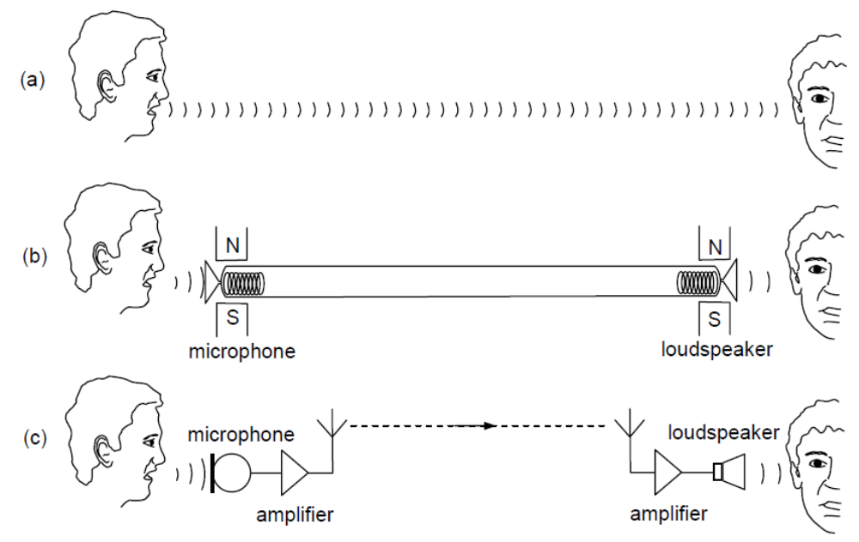
A Transmitter and A Receiver
Transmitter
Receiver
In all communication there is always a transmitter and a receiver. As technology advances, the transmitter and receiver are getting further apart. If everyone is to send out their information signals through antenna as they are, then all that we receive is just noise and no information.

Slide 3
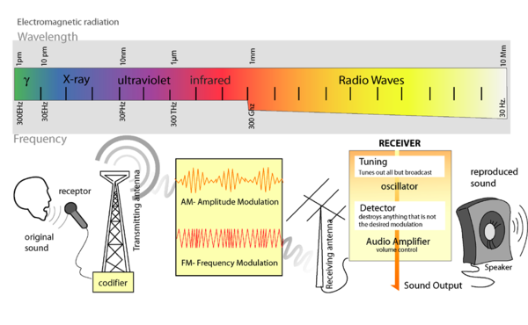
Carrier Wave
So technologists decide that we let the radio waves carry our information signals and assign different radio wave band to transmit various information.
Hence, they send to our receivers the amplitude modulated (AM) or the frequency modulated (FM) signals.

Slide 4
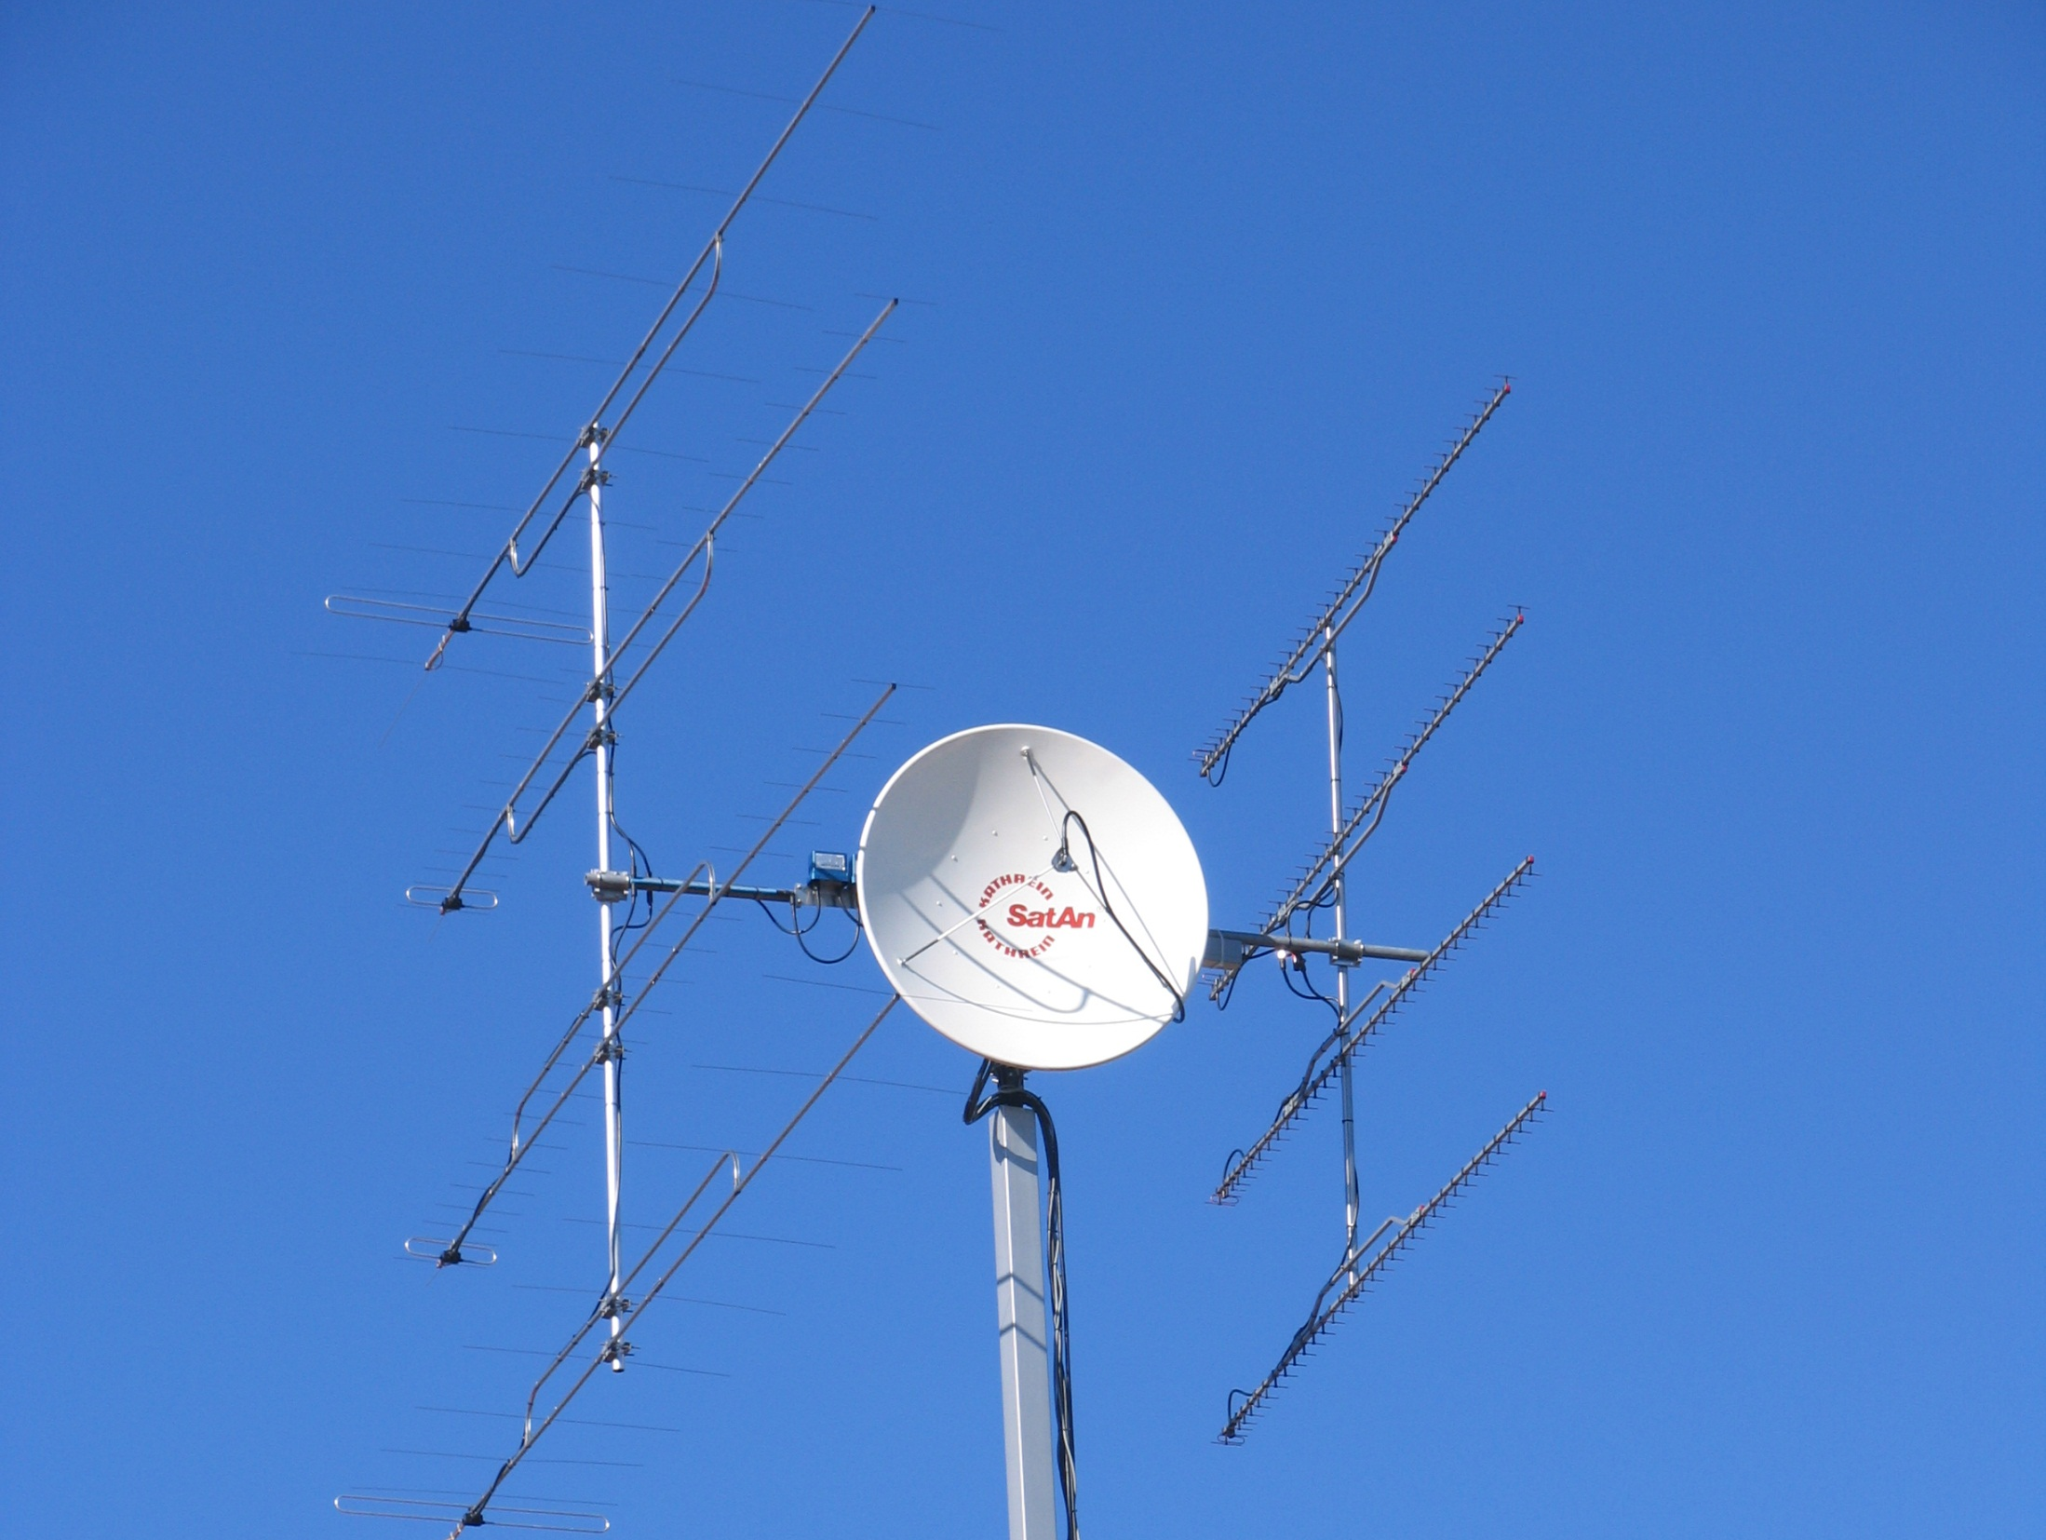
AM & FM
The signals that we receive
are either
amplitude modulated (AM)
Or
frequency modulated (FM)

Slide 5
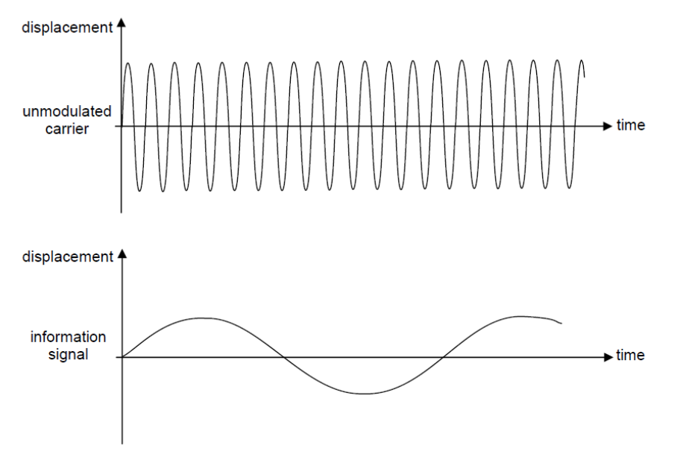
Modulation
Modulation is the process where one signal is added onto another carrier signal.
In our case, we use the radio waves and microwaves as the carrier.
The carrier is of sinusoidal form and hence carries the function,
x = x₀sinωt
where x₀ is its amplitude and
ω its angular frequency
both of which can be altered.
The carrier wave has a much higher frequency than the information signal.

Slide 6
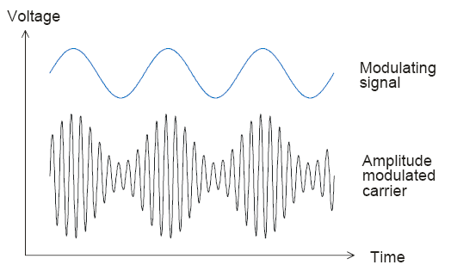
Amplitude Modulation (AM)
In amplitude modulation (AM) amplitude of the carrier wave is made to vary in synchrony with the displacement of the information signal.
Notes:
mention

Slide 7
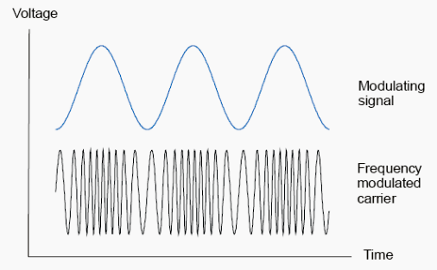
Frequency Modulation (FM)
In frequency modulation (FM) frequency of the carrier wave is made to vary in synchrony with the displacement of the information signal.

Slide 8
Example
A sinusoidal carrier wave has a frequency of 800 kHz and an amplitude of 5.0 V. The frequency deviation of the carrier wave is 30 kHz V⁻¹, that is, for every 1.0 V change in displacement of the signal, the frequency modulated by a sinusoidal signal of frequency 10 kHz and amplitude 2.0 V. Describe, for the carrier wave, the variation (if any) of the amplitude and frequency.
Solution:
The amplitude remains constant at 5.0 V
The frequency deviation = 30 × 2.0 = 60 kHz
Therefore, the frequencies fluctuate between (800 – 60) and (800 + 60) = 740 kHz to 860 kHz
This change of frequency occurs 10 000 times per second.

Slide 9
Advantage of Sending Out Modulated Signals
Many radio stations can now transmit signals at the same time in a particular area (without interference).
  Each radio station is given a different carrier wave frequencies.
  The receiver is adjusted or tuned to receive the desired frequency.
The aerials are transmitting and receiving the carrier frequencies and so need not be long to cater for the whole range of audible frequency of 20 Hz to 20 kHz.

Slide 10
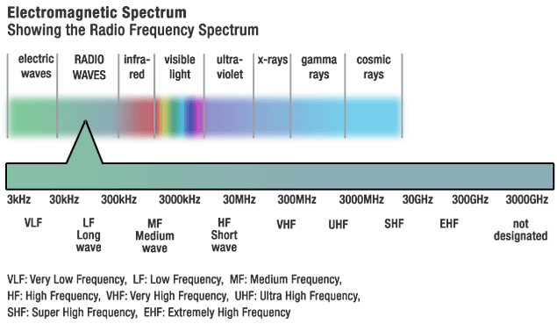
Wavebands
AM is transmitted in the long wave (LW) (30kHz-300kHz), medium wave (MW) (300kHz-3MHz) and short wave (SW) (3MHz-30MHz) wavebands.
FM is transmitted in the very high frequency (VHF) (30MHz-300MHz) waveband.

Slide 11
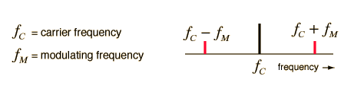
Sidebands & Bandwidth
Radio transmission involves putting audio frequency information on a much higher frequency electromagnetic carrier wave. This process produces frequencies which are the sum and the difference of the carrier and information signal frequencies.
These frequencies are called sidebands.
The difference between the two sidebands is the bandwidth.
Bandwidth is defined as the range of frequencies occupied by an amplitude modulated waveform.
Because of the existence of the sidebands, the frequency range or bandwidth necessary for radio transmission depends on this range of modulating frequencies.

Slide 12
Example
A particular transmitter is broadcasting an AM signal of frequency 200 kHz. The transmitter is broadcasting a programme of music with a maximum frequency of 4.5 kHz. Determine for this AM signal.
(a) The wavelength (b) the bandwidth
Solution:
(a) λ = c / f = 3.0 × 10⁸ /200 × 10³ = 1500 m
(b) Bandwidth = 2 × 4.5 = 9.0 kHz

Slide 13
Number of radio stations
Example:
AM radio is broadcast on MW waveband, which occupies a region of 300 kHz – 3 MHz of the EM spectrum.
If each AM radio station has a bandwidth of 9 kHz, how many radio stations could share this MW waveband?
Solution:
Number of radio station
= (Range of waveband) / bandwidth of each station
= (3000 – 300) / 9
= 300

Slide 14
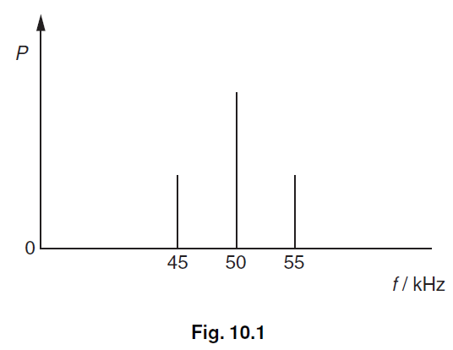
Example
Fig. 10.1 shows the variation with frequency f of the power P of a radio signal.
(a) State the name of
(i) the type of modulation of this radio signal,
(ii) the component of frequency 50 kHz,
(iii) the components of frequencies 45 kHz and 55 kHz.
(b) State the bandwidth of the radio signal.
(c) On the axes of Fig. 10.2, sketch a graph to show the variation with time t of the signal voltage of Fig. 10.1.

Slide 15
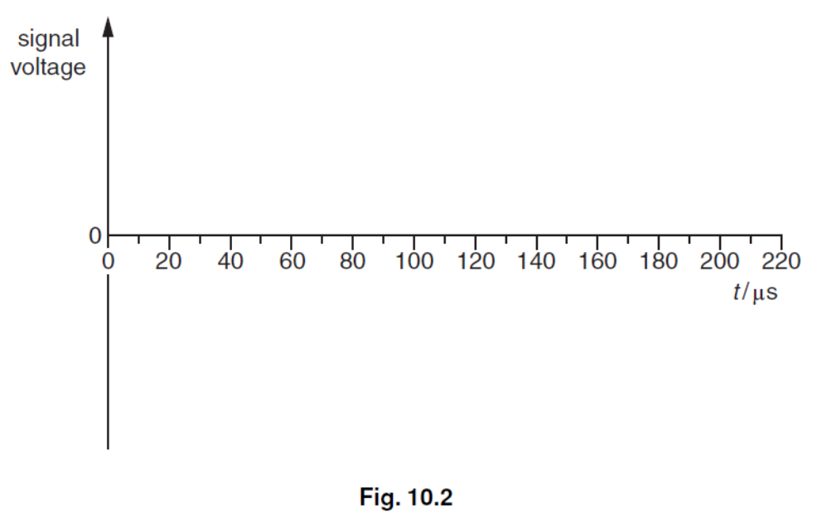
Solution
(a) (i) amplitude modulation
(ii) carrier frequency
(iii) sidebands
(b) 10 kHz
(c) sketch: general shape i.e. any wave that is amplitude modulated
correct period for modulating waveform (200 μs)
Correct period for carrier waveform (20 μs)

Slide 16
Bandwidth for Communication
Bandwidths are assigned for all types of broadcast communication and this imposes a maximum signal frequency which may be transmitted.
The bandwidths assigned to AM and FM radio are such as to limit the fidelity of music broadcasts in AM, but permit the luxury of stereo high-fidelity broadcasts by FM. (FM is transmitted in the VHF region)
The high signal frequencies associated with video broadcasting require higher bandwidths for channels assigned to television. (TV broadcast is transmitted in the UHF region)

Slide 17
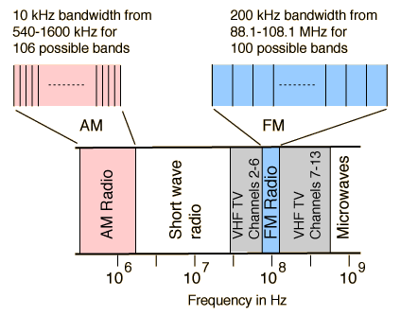
Radio Frequency Band
Because of the division of the FM band for the transmission of FM stereo, the frequency limit for music transmission is at 15 kHz.
This allows high fidelity signal transmission. The operational bandwidth is limited to 150 kHz, with 25 kHz on each side of that for guard bands. Actually FM stereo covers 106 kHz of that.
A guard band is an unused part of the radio spectrum between radio bands, for the purpose of preventing interference.

Slide 18
Relative Advantages of AM & FM
Overall, AM transmission has lower quality than FM transmission because
AM can pick up noise (interfering radiation from the surrounding such as a passing motorbike). FM is not affected as it varies in frequency not amplitude.
AM lack higher frequencies as its bandwidth on LW and MW is 9 kHz, the maximum audio frequency that can be broadcast is 4.5 kHz.
There is a compromise in quality of music due to the narrow bandwidth of AM. Music or audio has a maximum frequency of 15 kHz.
Overall, AM transmission is cheaper than FM because
Due to its narrow bandwidth, more AM radio stations can share a waveband.
AM on LW, MW and SW can be propagated over a larger distance. FM has only a range of 30 km by line-of-sight.
AM transmitter and receivers are electronically simpler and cheaper.

Slide 19
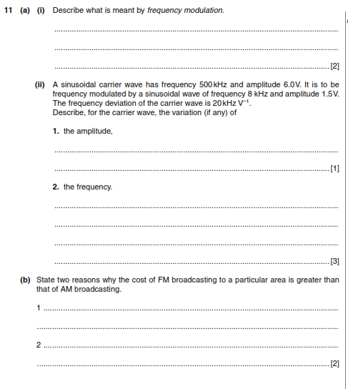
P4 JUNE 08

Slide 20
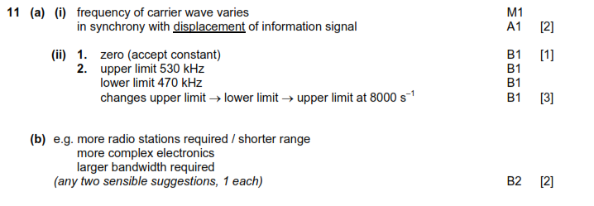

Slide 21

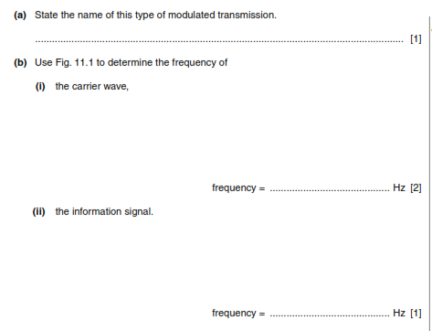
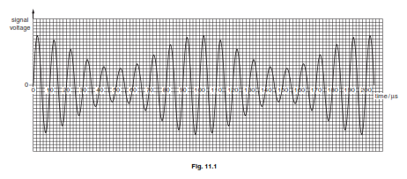
P42 NOV 09

Slide 22
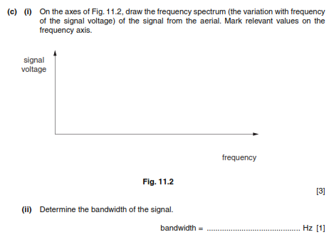

Slide 23
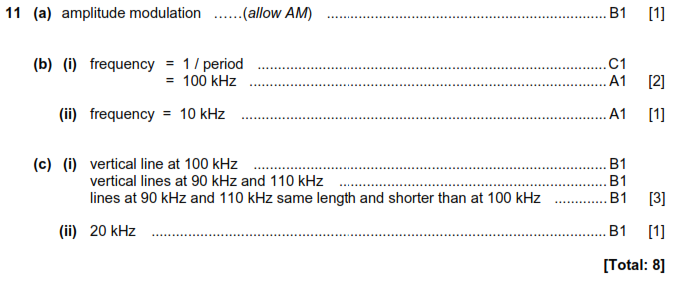
ANSWER

Slide 24
Analogue Vs Digital

Slide 25
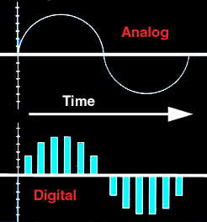
Analogue Vs Digital
Analogue signal has continuous values, it has the same variation with time as the information itself.
Digital signal is a series of ‘highs’ and ‘lows’ with no values between the ‘highs’ and ‘lows’.

Slide 26
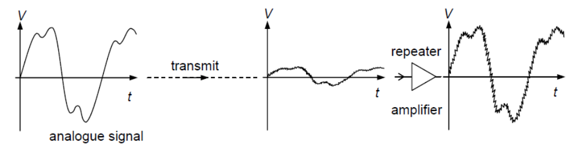
Problem with Analogue Signal
Analogue signal picks up noise and the noise is amplified together with the original signal by amplifiers.
Noise is the unwanted random power added onto the attenuating original signal.
One source of noise is the thermal vibrations of the atoms of the medium that the signal is passing.
Attenuation is the gradual reduction of the signal power and hence the signal has to be amplified by repeater amplifier at regular distance.

Slide 27
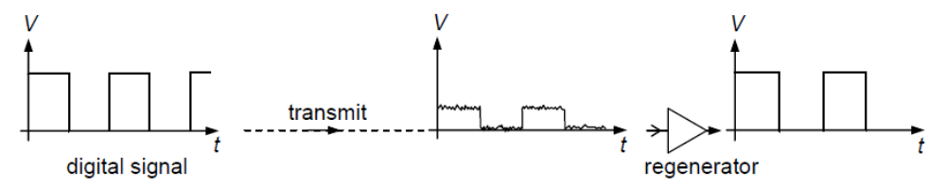
Advantage of Digital Signal
A digital signal can be transmitted over very long distances with regular regenerations without becoming increasingly noisy, as would happen with an analogue signal.
Attenuation and addition of noise also happen to digital signals but as noise consists, typically, of small fluctuations, they are not amplified by the regenerator amplifiers.
The regenerator amplifiers reproduce the original digital signal and, at the same time, ‘filter out’ the noise.

Slide 28
Advantage of Digital Signal
A further advantage of digital transmissions is that they can have extra information – extra bits of data – added by the transmitting system. These extra data are a code to be used by the receiving system to check for errors and to correct them before passing the information on to the receiver.
Nowadays, digital circuits are generally more reliable and cheaper to produce than analogue circuits. This is, perhaps, the main reason why, in the near future, almost all communication systems will be digitally based.

Slide 29
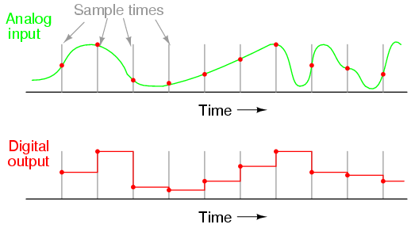
Conversion
An analogue-to-digital converter (ADC) converts the analogue signal into digital signal through sampling
An Digital-to-analogue converter (DAC) reconverts the digital signal into analogue signal

Slide 30
Analogue-to-Digital Converter (ADC)
In an analogue-to-digital converter (ADC), the analogue voltage is sampled at regular intervals of time, at what is known as the sampling frequency or sampling rate.
The value of the sample voltage measured at each sampling time is converted into a digital (binary) number that represents the voltage value.
An ADC converts the analogue signal into digital signal
An DAC reconverts the digital signal into analogue signal

Slide 31
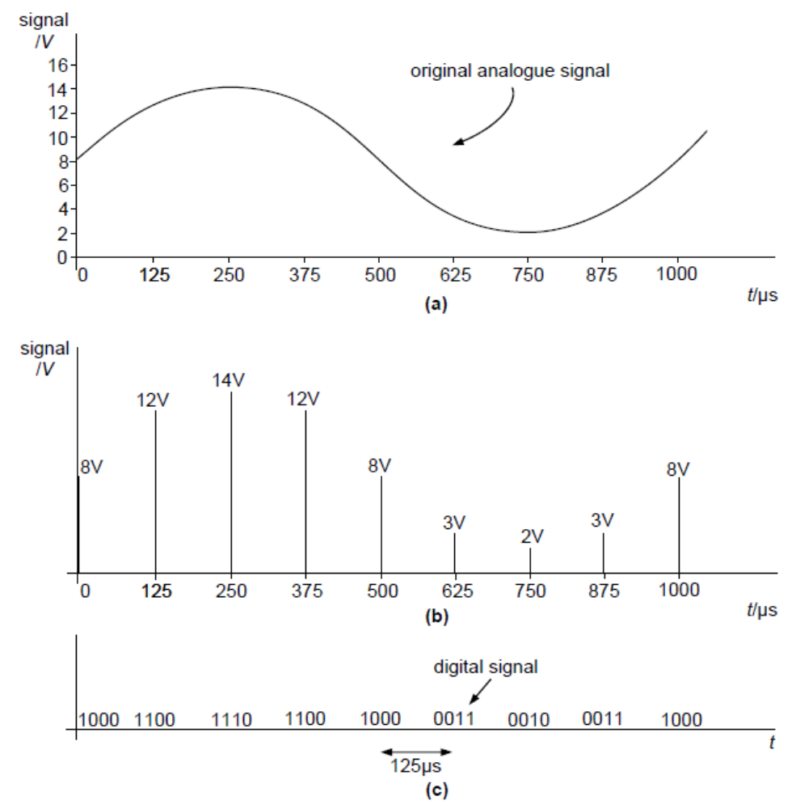
Analogue to Digital Conversion
Here is an example where an analogue signal is sampled at every 125 μs and the digital signal recorded as a 4-bit number

Slide 32
ADC: Value Given
Note that the value given to the sampled votage is always the value of the nearest increment below the actual sample voltage.
Example:
An analogue signal of 14.3 V would be sampled as 14 V and one of 3.8 V would be sampled as 3 V.

Slide 33
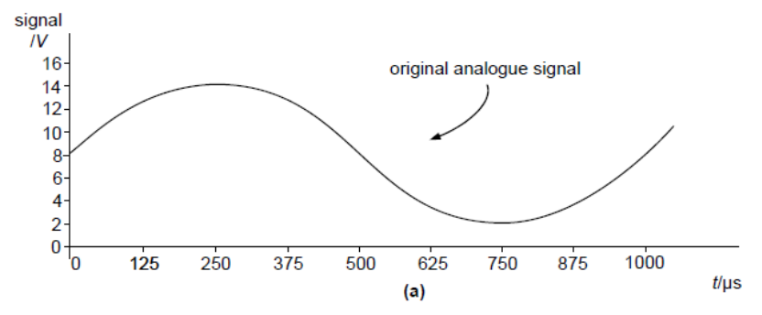
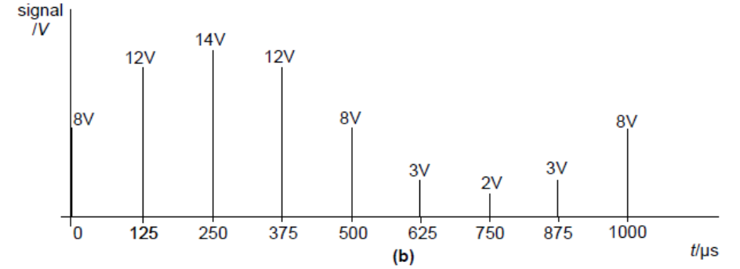
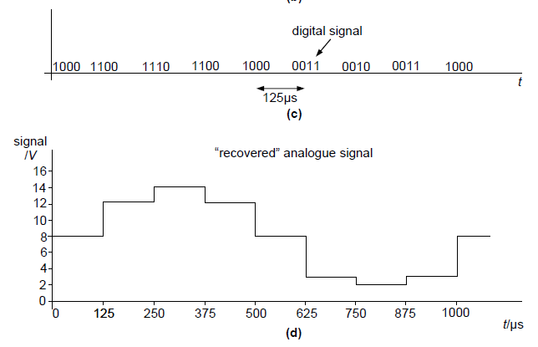
The Recovered Signal
The recovered signal is very ‘grainy’, consisting of large steps.
It can be improved by
  Using more voltage levels / bits
  Sampling at higher frequency.

Slide 34
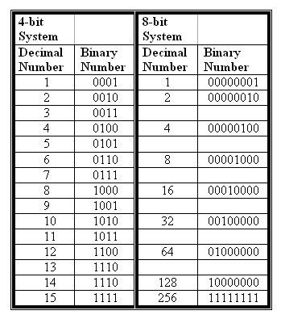
Bits and Voltage Levels
A binary digit is referred to as a bit.
The number of bits in each digital number limits the number of voltage levels.
In the example given, there are 4 bits and hence 2⁴ = 16 voltage levels.
In practice eight or more bits would be used for sampling.
An eight-bit number would give 2⁶ = 256 voltage levels.

Slide 35
ADC: Sampling Frequency
The choice of sampling frequency also determines the amount of information that can be transmitted.
The greater the sampling frequency the more faithful is the reproduction of the original signal
About 100 years ago, Nyquist showed that , in order to recover an analogue signal of frequency f, then the sampling frequency must be 2f.
For good quality reproduction of music, the higher audible frequencies of 20 kHz must be present. Therefore the sampling frequency is 44.1 kHz.
Human voice range is 90-1200 Hz. Therefore in a telephone system the highest frequency transmitted is restricted to 3.4 kHz, the sampling frequency is 8 kHz.

Slide 36
Example
An analogue signal is sampled at a frequency of 5.0 kHz. Each sample is converted into a four-bit number and transmitted as a digital signal.
Fig. 10.1 shows part of the digital signal.
The digital signal is transmitted and is finally converted into an analogue signal.
(a) On the axes of Fig. 10.2, sketch a graph to show the variation with time t of this final analogue signal.
(b) Suggest two ways in which the reproduction of the original analogue signal could be improved.

Slide 37
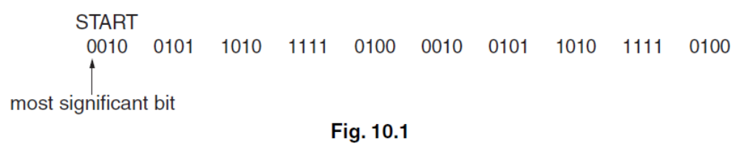
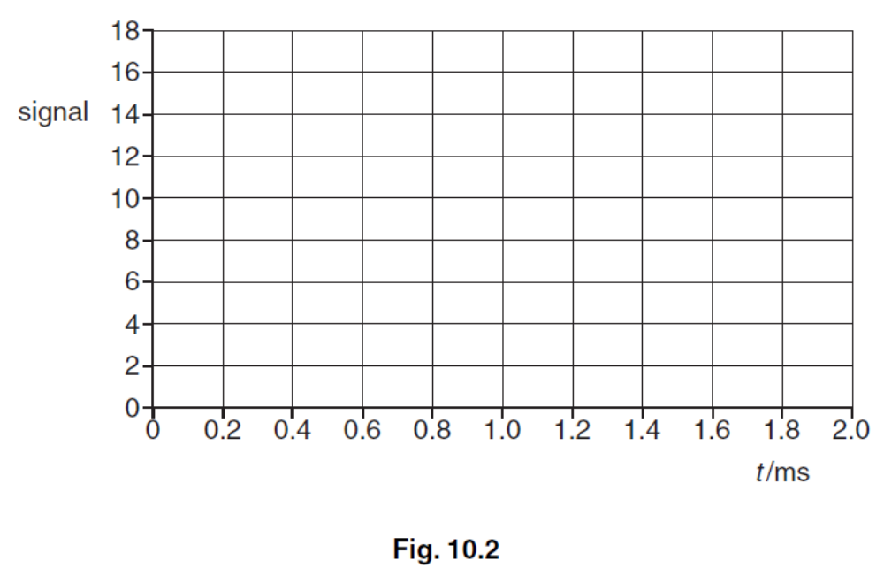
Solution
(a) correct values of 2, 5, 10, 15 and 4
graph drawn as a series of steps
steps occurring at correct times
(b) sample more frequently
greater number of bits

Slide 38
The End

